Slide 1


STALL DETECTION
By Droids Robotics and Hoosier Girlz
ADVANCED PROGRAMMING LESSON
Copyright © 2014 Droids Robotics www.droidsrobotics.org

Slide 2
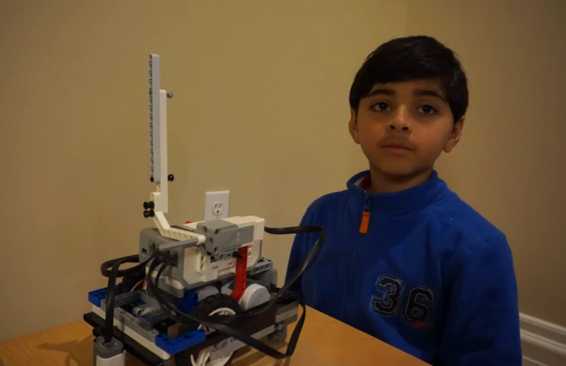
What is an Stall Detection and Why use it?
Stall detection is a program that stops your motor when the motor gets stuck
When your motor gets stuck, you usually have to grab your robot and get a touch penalty
When you use stall detection techniques, your robot will move on to the next block
Click on Video to learn
about Stall Detection

Slide 3
Move Degrees vs. Move Seconds
In our lesson on Move Blocks (Intermediate tab), we said that if you use Move Degrees, your motor may get stuck
We told you that Move Seconds helps avoid stalls, but is not as accurate
Are these the only choices?
How can you use Move Degrees and prevent stalls?
We show you how in this lesson

Slide 4
Requirements
In this lesson, you will need an arm connected to a motor
We have set our code to use a medium motor connected to motor A – this can be changed to suit your team’s needs
Follow along using the EV3 Code provided. Start with Step 1

Slide 5
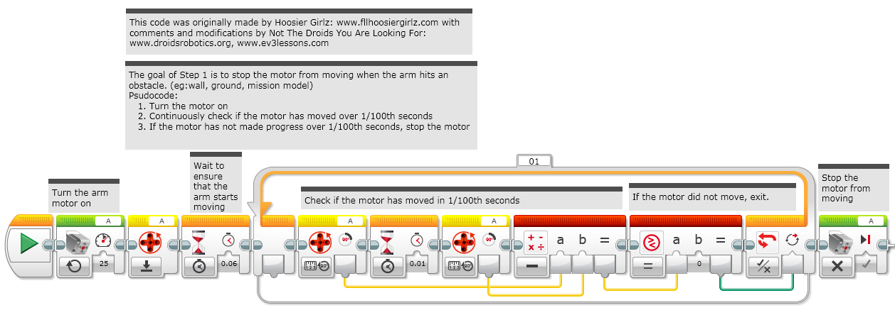
Step 1: Move Until Stall

Slide 6
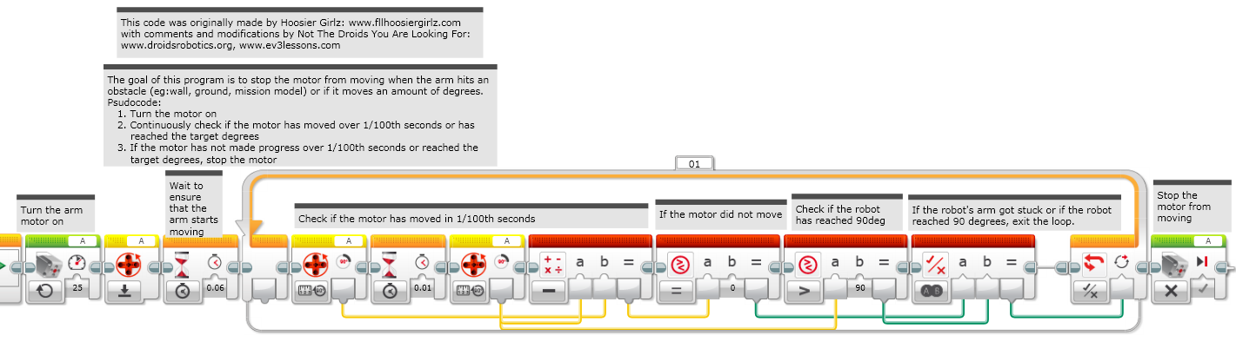
Step 2a: Move Degrees + Stall Detection

Slide 7
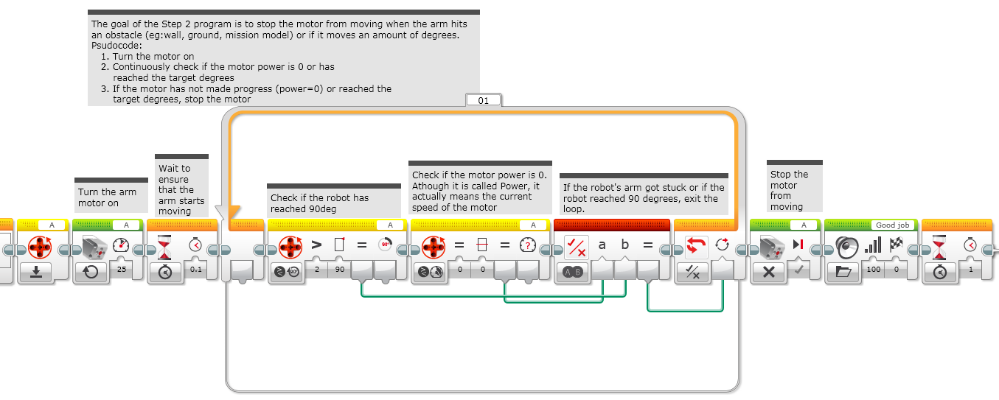
Step 2b: Alternate Move Degrees + Stall Detection
These blocks are just for the video

Slide 8
Credits
This lesson was created by Sanjay and Arvind Seshan from Droids Robotics. The Code was created by both Hoosier Girlz and Droids Robotics.
Step 1 and 2a by www.fllhoosiergirlz.com
Step 2a and 2b by www.droidsrobotics.org
Please give credit to the teams who authored the code.
More lessons at www.ev3lessons.com

